Slide 1
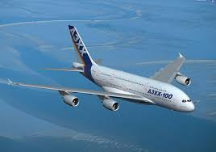
Examiner privileges

Slide 2
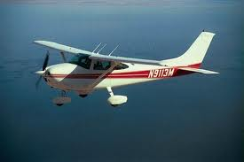
Flight Examiner FE
Possible general limitations
Aircraft, Simulator, PC, SKT
Following privileges can be entered certificate
SPL, BPL, LAPL, PPL, CPL, SEP, SET, TMG, MEP, SP typeratings non-HPCA, SP SE helicopters TR, SP ME helicopters TR
Possible specific limitations
None

Slide 3
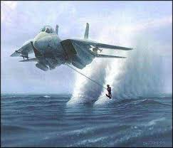
Class Rating Examiner CRE
Possible general limitations
Aircraft, Simulator, PC, SKT
Following privileges can be entered certificate
SEP, TMG, MEP, SET, SP typeratings non-HPCA, renewal and revalidation of associated IR if complies with requirements
Possible specific limitations
None

Slide 4

Type Rating Examiner TRE(SPH)
Possible general limitations
Aircraft, Simulator, PC, SKT, SP, MP
Following privileges can be entered certificate
SP TR, ATPL, TRI revalidation and renewal of associated IR
Possible specific limitations
None

Slide 5
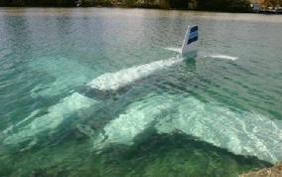
Type Rating Examiner TRE(SPA)
Possible general limitations
Aircraft, Simulator, Pc, SKT, SP, MP
Following privileges can be entered certificate
SP HPCA, TRI, revalidation and renewal of associated IR
Possible specific limitations
None

Slide 6

Instrument Rating Examiner IRE
Possible general limitations
Aircraft, Simulator, PC, SKT
Following privileges can be entered certificate
IR-SP-SE, IR-SP-ME, IR-SPA-MP, IR-SP-non-HPCA
Possible specific limitations
None

Slide 7
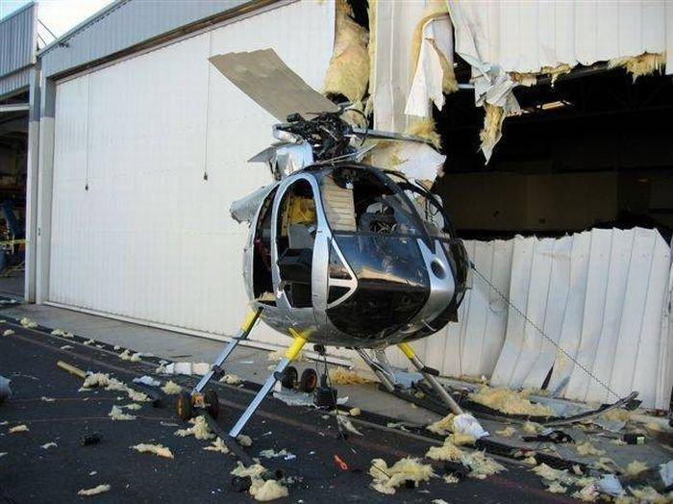
Flight Instructor Examiner FIE
Possible general limitations
Aircraft, Simulator
Following privileges can be entered certificate
FI(A), CRI(A), IRI(A), TRI(A)(SP), FI(H), IRI(H), TRI(H)(SP) and for FIE(As,S,B) assessment of competence according to instructor certificate priviliges
Possible specific limitations
None

Slide 8
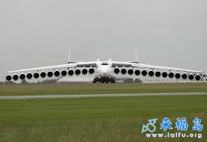
Type Rating Examiner TRE(MPA)
Possible general limitations
Proficiency check, Skilltest
Following privileges can be entered certificate
MP TR, MPL, ATPL, TRI, renewal and revalidation of associated IR
Possible specific limitations
Aircraft, Simulator

Slide 9

Type Rating Examiner TRE(MPH)
Possible general limitations
Proficiency check, skilltest
Following privileges can be entered certificate
MP TR, ATPL, TRI, renewal and revalidation of associated IR
Possible specific limitations
Aircraft, Simulator

Slide 10
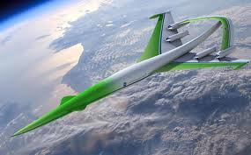
Synthetic Flight Examiner SFE(A)
Possible general limitations
Proficiency check, skilltest
Following privileges can be entered certificate
MP TR, MPL, (ATPL), SFI, renewal and revalidation of associated IR
Possible specific limitations
None

Slide 11
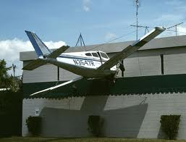
Synthetic Flight Examiner SFE(H)
Possible general limitations
Proficiency check, skilltest
Following privileges can be entered certificate
MP TR, (ATPL), SFI, renewal and revalidation of associated IR
Possible specific limitations
None

